Slide 1
Study Objective
Long term trend analysis of reservoirs using remote sensing data
Identification of the potential drivers for the trend of storage change
Frame these as science or research questions; try establishing a testable hypothesis or a few hypotheses. Please just do not do simple data analysis or recording of trends. Readers want to know why they should care about your study. PhD students should be able to think like that by now.
Methodology
Reservoirs were divided into categories based on Köppen–Geiger climate classification
(in your koppen map, please do not show the ocean with a color, it’s irrelevant)
A bigger question is why just climate? What role is the climate playing here for dams?
Is climate correlated to dam size, operation? What about other factors (again tied to the above research questions) –
population density; economic development at the granular level of a dam’s service area
5-year moving average of the reservoir storage change data were considered
Long term trend was calculated for different climate region and construction period
Daily 0.05⁰ Chirps precipitation was derived for each climate zone
(if you are doing 5 year moving avg of storage, why aren’t you doing the same for precipitation then?
And isn’t this for each climate zone too coarse? You should do it for each drainage area of a dam and run correlation of trends
Annual mean of precipitation was compared with the storage change
Major Findings
Only one reservoir was in cold climate (discarded from further analysis)
Almost all of the reservoirs showed negative trend in storage change – I’m still skeptical for a variety of reasons and your poor analysis. At the PhD level you need to be more rigorous and conceptually grounded
No significant relationship with the storage change data –Not sure what this means. Finally – why should we care about your findings? I don’t see how they are useful to move forward or how actionable is it? Say for management, climate change, better planning etc. I hope you can bring those up in the next round and in the paper

Slide 2
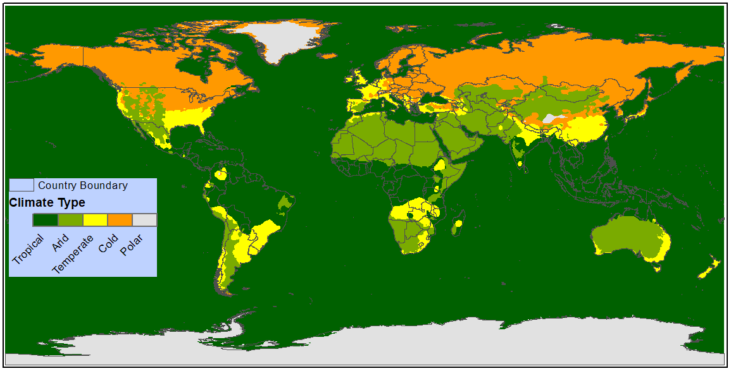
Köppen–Geiger climate classification system why do we care about oceans here?

Slide 3
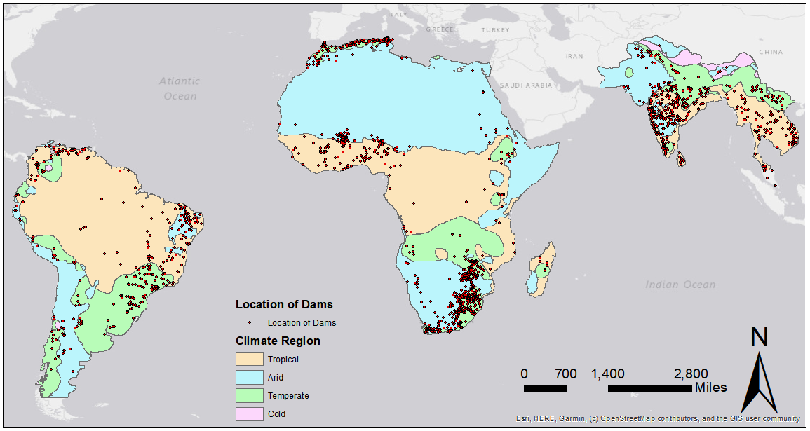
Köppen–Geiger climate classification system for RAT Framework (in the next stage, you can look into population density or growth rate, economic development of each dam’s drainage area. Koppen zones are too coarse)

Slide 4
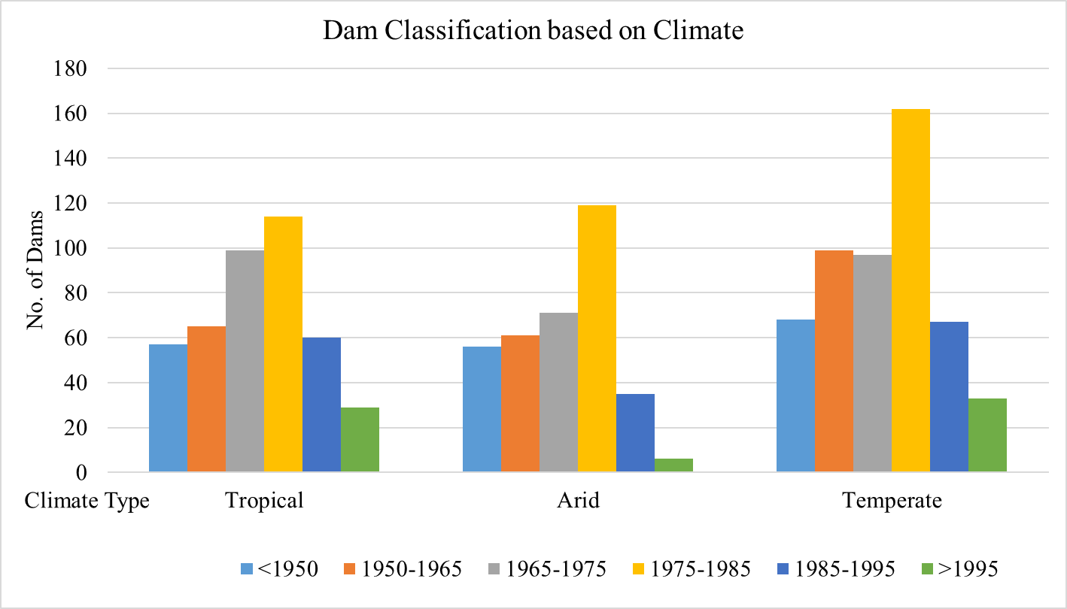
Classification of RAT Dams based on Climate Classification The year of construction is more meaningful if you represent it as ‘age’ as we have done in our 2010-2012 papers. Age today is an indication of how old the dam is, how much sedimentation it might have experienced and overall how much hydroclimatological change and operations it is a witness to

Slide 5
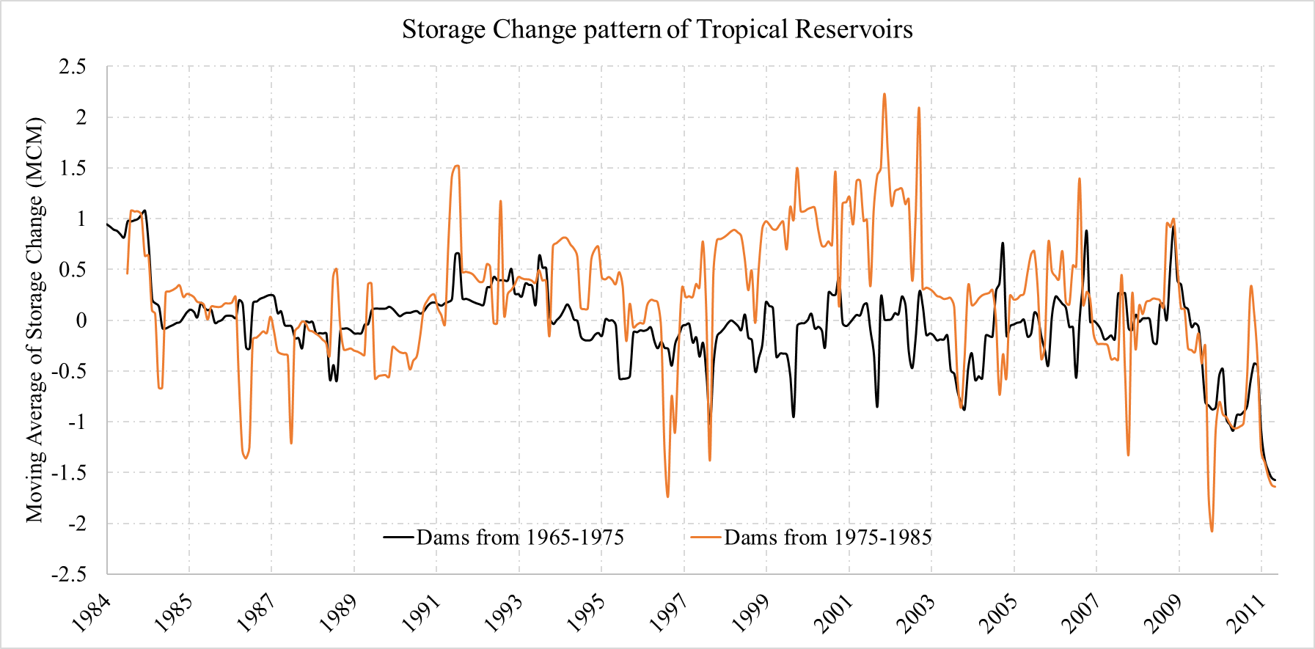
5 year moving mean of Tropical Reservoirs To me the two lines represent dams that are either 40 years old or 50 years old. That’s not much of a difference. You can either keep doing more lines as 30, 40, 50 and 60 year old and see if age is playing a role or just show a better contrast between very old (50+ year) and recent (<30 year). Then we can see if age is playing a role. Otherwise, I don’t know what this 1975 cut off really means. What’s so special about 1975. Again, Nishan PLEASE THINK PHYSICALLY AND USE COMMON SENSE

Slide 6
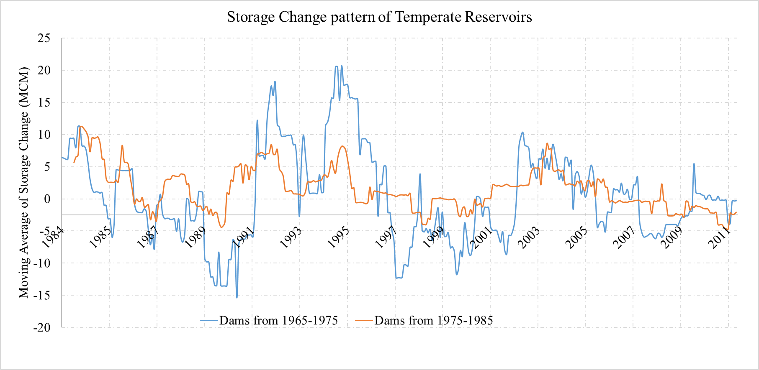
5 year moving mean of Temperate Reservoirs same comment as slide 5

Slide 7
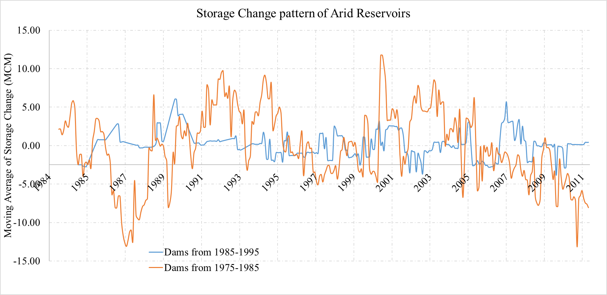
5 year moving mean of Arid Reservoirs same comment as slide 5

Slide 8
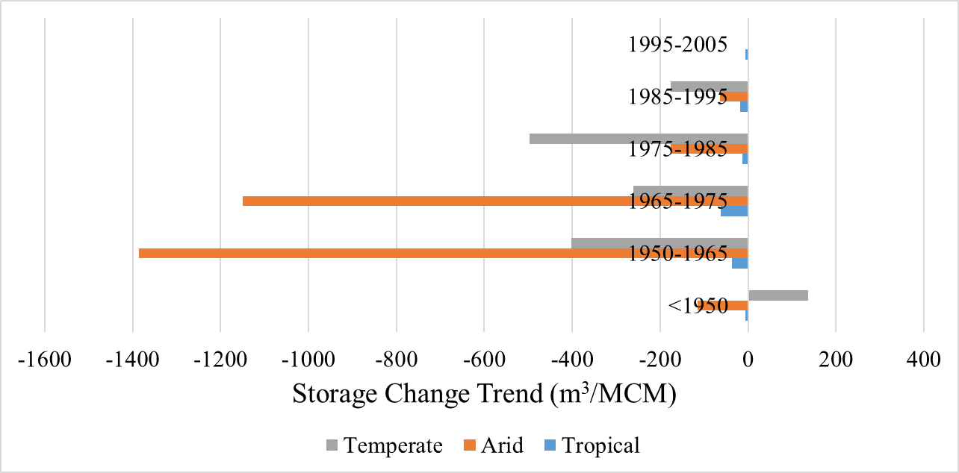
Storage Change Trend of Reservoirs based on Construction year and Climate Type Ok now, I’m seeing something as a function of ‘age’ – the younger dams have experienced much less negative storage change. What could be the reasons? Better land management, less sedimentation, hydrological change in precip patterns? I’m also wondering, since dams are in various sizes, should we normalize them (from 0-1) or break down this as small, medium and large? I know it becomes a lot, but if you present in tabular fashion then we don’t have to grapple with too many charts.
Small dams storae less than a year’s runoff, medium about a year and large multiple years. Small and medium dams follow hydrology while large dams don’t – they are more for drought. So when you compare with precip climatology in that dam’s drainage area, you may see interesting patterns for small vs medium vs large dams
M³/MCM/Month | <1950 | 1950-1965 | 1965-1975 | 1975-1985 | 1985-1995 | 1995-2005 | Mean
Tropical | -5.51 | -36.56 | -62.19 | -13.02 | -17.29 | -5.52 | -23.35
Arid | -115.22 | -1385.44 | -1150.27 | -176.22 | -64.64 | -1.15 | -482.15
Temperate | 136.82 | -402.80 | -260.31 | -496.85 | -175.53 | 0.51 | -199.70
Mean | 5.36 | -608.27 | -490.92 | -228.69 | -85.82 | -2.05 | -235.07

Slide 9
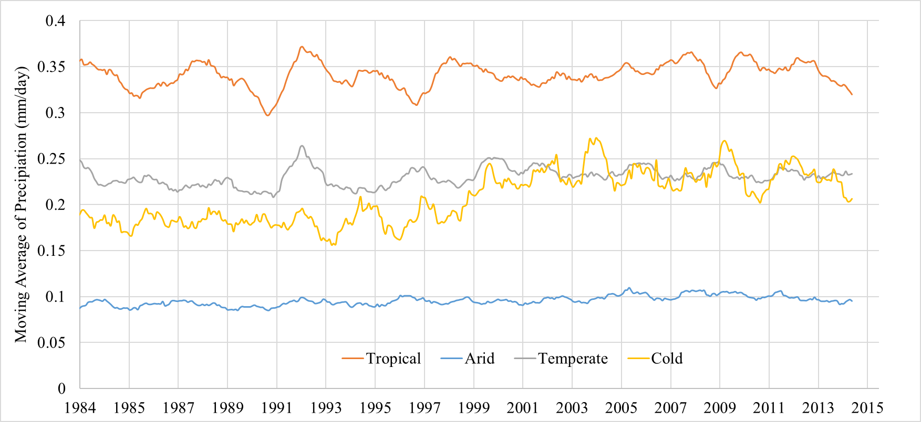
Precipitation Trend over different Climate Type – as a first cut this is fine. But if you want to correlate 5 year moving average of precip with 5 year moving average of storage change, then do it for dam’s drainage area as a function of climate, age and dam size. You may see very interesting patterns.
Chirps Daily precipitation at 0.05 degree resolution
Converted into one (should be five in my opinion) year moving average monthly precipitation

Slide 10
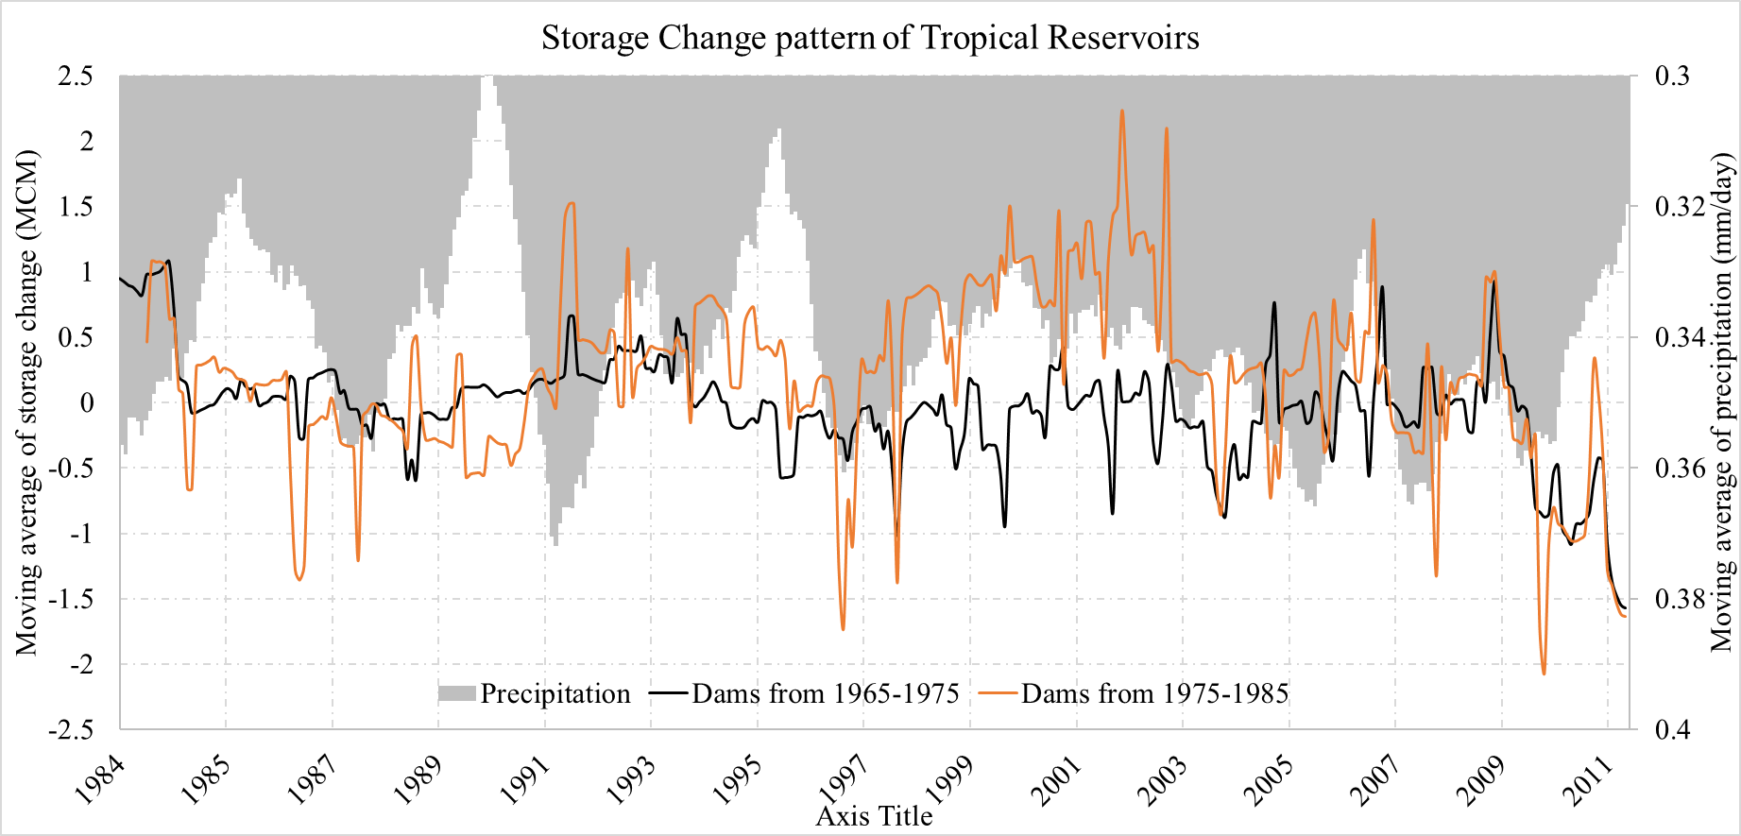
Precipitation Trend with storage change for tropical reservoirs see comment on slide#9

Slide 11
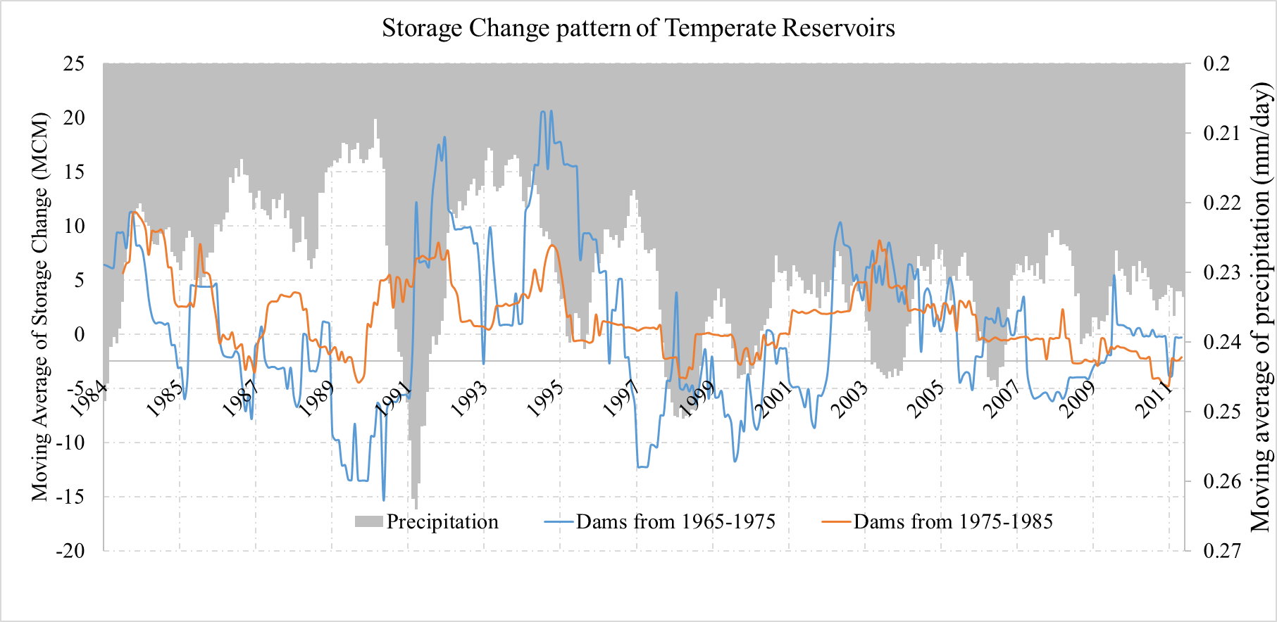
Precipitation Trend with storage change for Temperate reservoirs

Slide 12
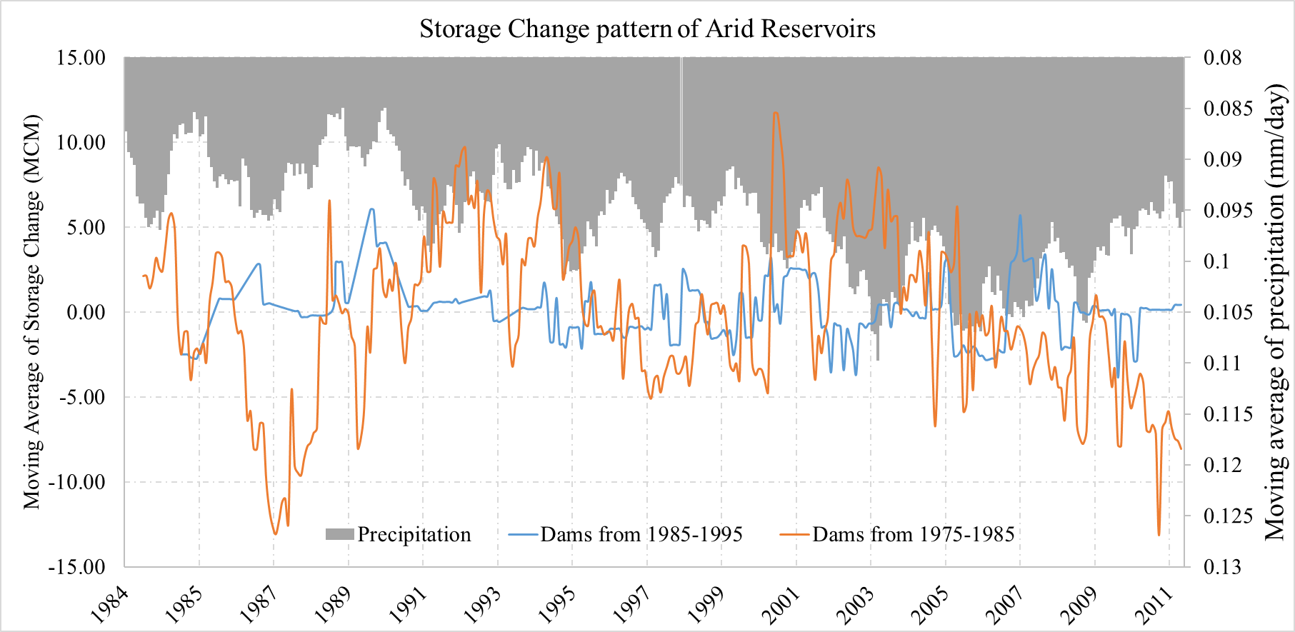
Precipitation Trend with storage change for Arid reservoirs same comment as slide 9

Slide 13
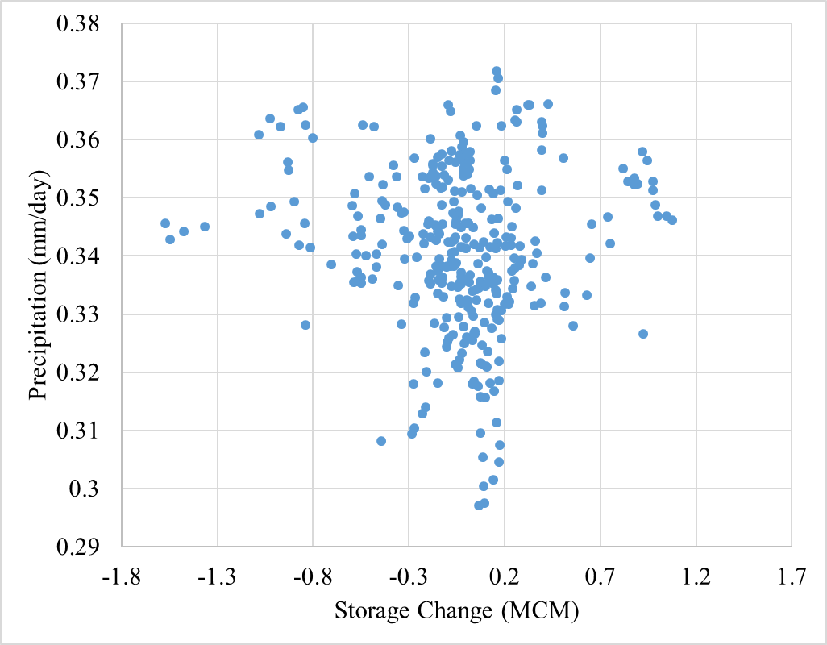
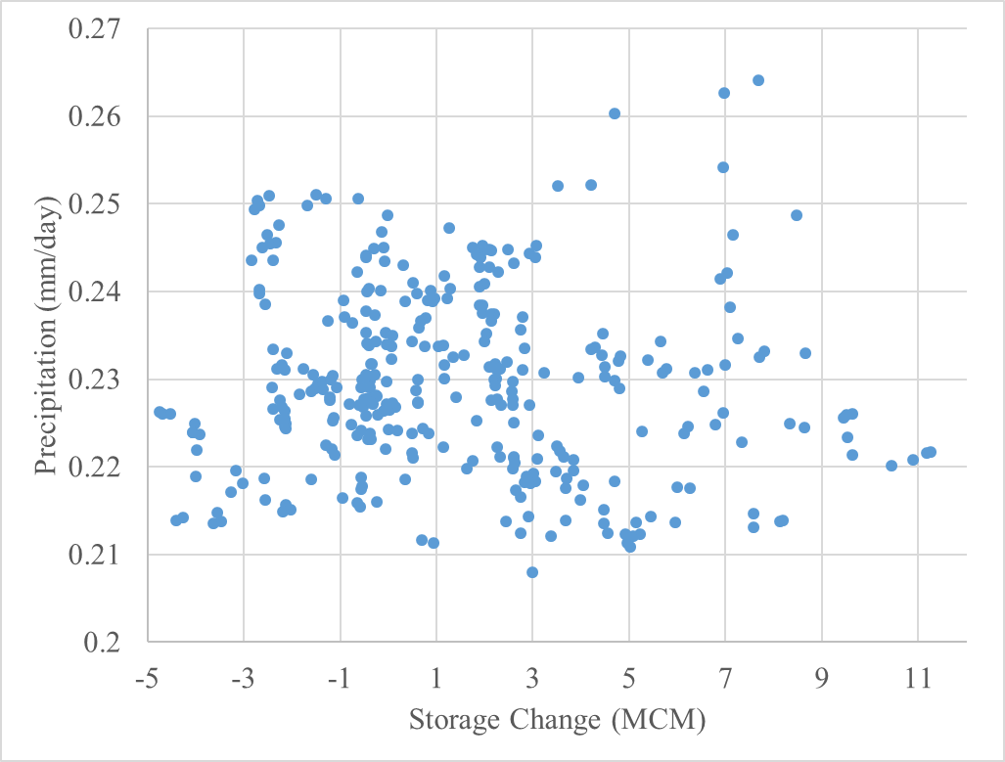
See my previous comments. These scatter plots mean nothing. First do a more apples to apples comparison, then break down per age and size as well. There might be other factors you can look into.
Scatter plot of precipitation and storage change
Temperate reservoirs (Dams of 1975-1985)
Scatter plot of precipitation and storage change
Tropical reservoirs(Dams of 1975-1985)

Slide 14
Currently working on
Comparison of Reservoir Inflow with storage change
Comparison of Evapotranspiration (evaporative index) with storage change
Before you embark on anything new, please think through VERY DEEPLY my comments in ALL the previous slides. And then if you do the analysis/comparisons consistently for inflow and E, you might see something useful. For example for inflow, you can compare 5 year moving average with 5 year moving average storage change and precip as a function of size, age. I think E is less informative as it’s modeled. But it’s worth a try. If there’s nothing there in E, you can drop it. Just a comparison of storage change, inflow, as a function of size, age, climate and precipitation climatology is good enough for a paper if you can pinpoint some logic and verify hypotheses. I’ve already shared one hypothesis that small dams follow seasonal hydrology, while medium dams are in between and large dams do not, but will be impacted by long term trends. THINK, THINK, THINK

